Slide 1
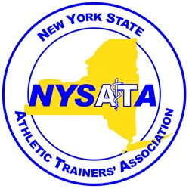
NYSATA 40 Year Anniversary & Hall of Fame
November 6, 2016
State university of new york at Cortland

Slide 2
Early years of Athletic Training
In the 70s & 80s:
NATA developed approval of educational curriculums (had originally been established in 1969)
FIRST CERTIFICATION EXAM WAS ADMINISTERED IN 1970
4 ways to sit for the exam
Graduate from NATA approved program
Graduate from an internship/apprentice program
Graduate from a Physical Therapy program
Special Consideration (5 years previously “actively engaged” as an athletic trainer)

Slide 3
Early years of Athletic Training
Title IX in 1972
athletic training educational programs become coeducational
more women enter the profession
NATA encouragement:
individual states should form their own societies/associations
pursue licensure similar to other healthcare professions

Slide 4
Origin of NYSATA
January 1976 - 27th Annual Meeting of EATA -
First meeting of ATs from NY to discuss forming a state organization
John Sciera of Cortland elected as NYSATA’s 1st president
January 1978
Advancement and Professional Education Committee appointed – became Licensure Committee
Educational committee formed -Ken Knight Chair

Slide 5
NYS Athletic Training Education Programs
Initial four NATA approved athletic training programs in NY state:
Cortland, Ithaca, Canisius and Brockport State
Additional Current AT Education Programs:
Alfred, Dominican, Long Island, Hofstra, Stony Brook, Daemen,

Slide 6
The First Meeting of NYSATA
March of 1976
Initial “formal” meeting of the NYSATA
small group gathered in John Sciera’s living room in Cortland
Ideals used to establish by-laws and determine major goals for the association included:
A certified athletic trainer in every high school in NY
Investigate possibility of licensing athletic trainers in NY
and increase public relations for athletic trainers in NYS
Annual dues = $10.00

Slide 7
Attendees of the First Meeting of NYSATA
“Founding” meeting attendees included:
John Sciera (Cortland State)
Joe Abraham (Hobart College)
Mike Cappeto (Columbia University)
Kent Scriber (Ithaca College)
Gene Castrovillo (Alfred University)
Laurence Steve (NYC Area Physical Therapist)
Jack Koelmel (Albany State University)
Claudette Delameter (Albany State University)

Slide 8
Attendees of the First Meeting of NYSATA
“Founding” meeting Attendees (continued):
Hollis Powers (Plattsburgh State)
Peter Farrell (Potsdam)
Robert Kane (Clarkson)
Tom Sheehan Jr (RPI)
Don Lowe (Syracuse)
David Bailey (Oneonta)

Slide 9
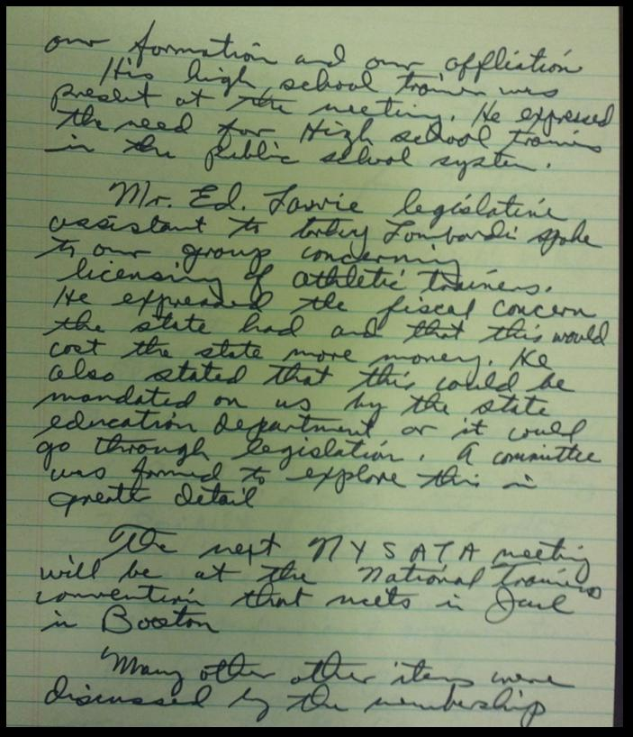
Original Notes from NYSATA’s First Meeting

Slide 10
Need for NYS Regulation of ATs
In 1976 NATA president, Frank George sent a letter to the NATA’s general membership encouraging individual states to seek licensure
Model legislation from NATA was sent to the licensure committee
The committee worked hard on strategies to move towards state regulation of athletic trainers

Slide 11
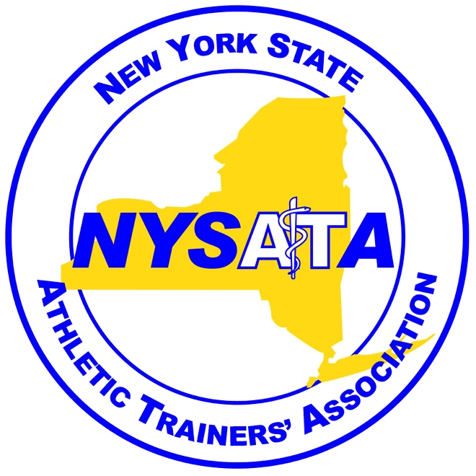
1976
Letter From
NATA President
Frank George

Slide 12
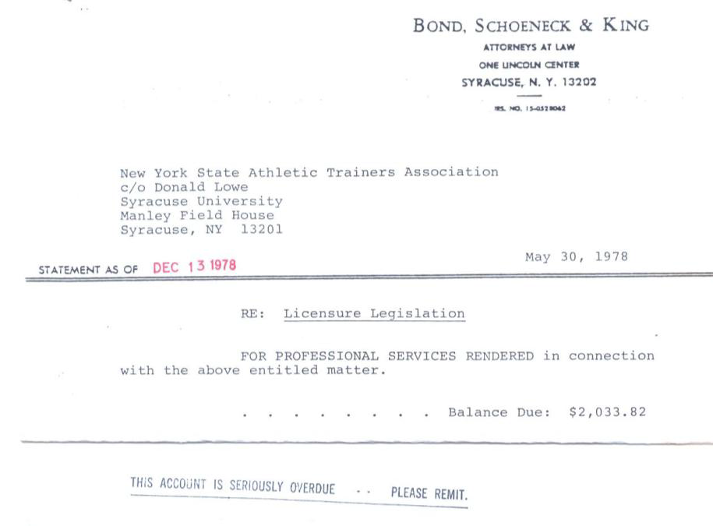
Need for NYS Regulation of ATs
1977 hired Syracuse based law firm
to advise NYSATA in legislative efforts toward introducing a licensure bill
Assessment $25:
All members were assessed $25 (due January 1, 1978) to help cover legal costs for the bill.
Picture of the bill of legal fees

Slide 13
Need for NYS Regulation of ATs
1978 Legislative Session
Extensive lobbying
assessment fees collected but did not cover all legal fees
January 1979
Legal debt incurred by NYSATA
NYSATA asked the firm to cease efforts

Slide 14
Need for NYS Regulation of ATs
Initial Bill introduced in April 1978:
Proposed Definition of Athletic Training:
“Practice of Athletic Training is defined as the use of various techniques of an employee of an education institution, a professional athletic organization as determined by the commissioner upon the supervision of a physician to: prevent athletic injury from occurring; provide initial care of an athletic injury; provide support for an athletic injury; perform tests and measurements as an aid in the evaluation of an athletic injury; apply physical modalities such as heat, light, cold, air, water, electricity, sound, massage, therapeutic exercise and their use for the effective treatment and rehabilitation of an athletic injury”

Slide 15
Need for NYS Regulation of ATs
Limited legislative support:
Due to small number of the NYSATA members
athletic trainers lack visibility
Pushback for initial bill from other professional organizations
They felt scope of practice for Athletic Trainers was not appropriate

Slide 16
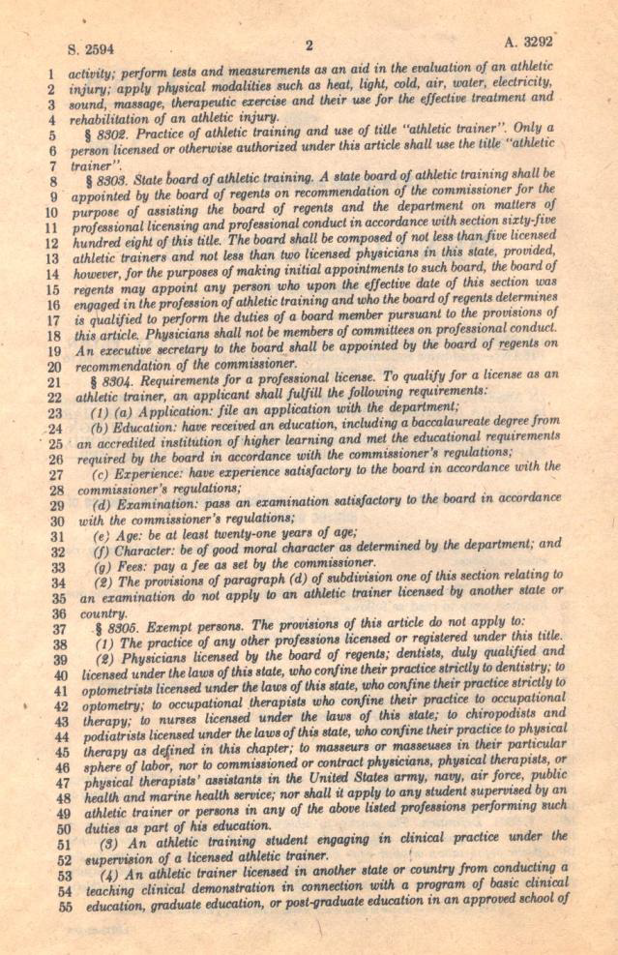
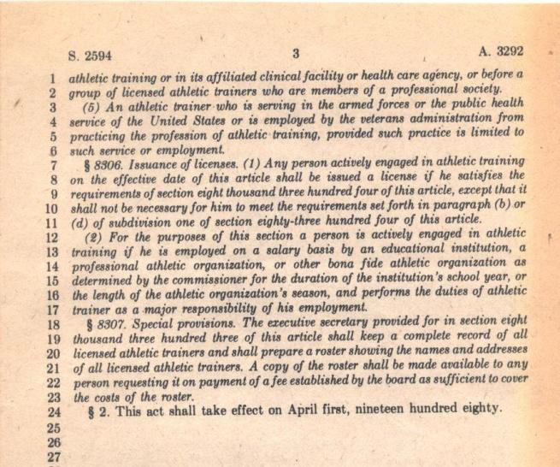
Pictures of original bill

Slide 17
Need for NYS Regulation of ATCs
Early 1980s
NYSATA joins New York State Association of Health, Physical Education, and Recreation (NYSAHPER)
Larger membership numbers should help with legislation
1983
NYSAHPER provides no benefit toward legislative efforts,
NYSATA became independent again
NYSATA dues: $20 for certified and $5 for students

Slide 18
NYS Regulation of ATs
1992
NYSATA hires lobbyist Mary Ann McLean
Bill Passes Senate and Assembly!
Governor Mario Cuomo signs the bill!
Current definition for athletic training
Steven Norman, president (1990-1992)
Jenny Hathaway Monaco is NYSATA’s first female president (1992-1994)

Slide 19
Passage of Athletic Training Bill

Slide 20
The Annual NYSATA Meeting
Annual Meetings:
Binghamton 1981 – First meeting
Locations: Cortland, Rochester, Syracuse, Long Island…
Late 1980s to early 2000s,
Combined with Empire State Games
Early 2000s – present
a separate meeting

Slide 21
Empire State Games, New York State Athletic Trainers & NYSATA
Excellent venue for bringing professional exposure
Provides recognition of athletic trainers to athletes
Exposed the public and other healthcare professionals to the profession of athletic training
Through the years, more physicians and athletic trainers volunteered and the group always led the opening ceremony procession

Slide 22
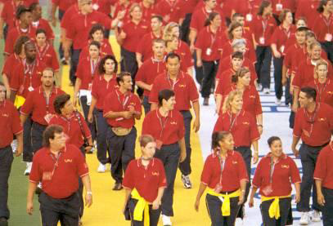
Empire State Games Opening Ceremony

Slide 23
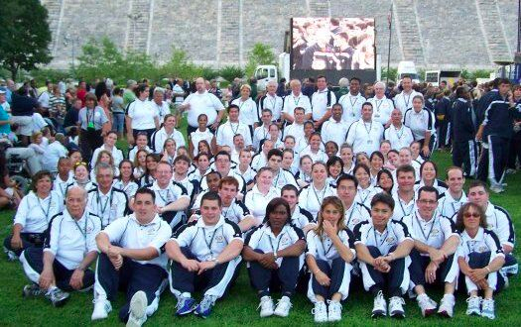
Empire State Games

Slide 24
Public Relations Efforts
Increased efforts to educate the public about Athletic Trainers
To assist with legislative efforts
Press Releases written monthly/bimonthly & distributed through a public relations company
Contests during NATA AT Month
Athletic Training Recognition Week in Fall
Attend NYS conferences as vendors

Slide 25
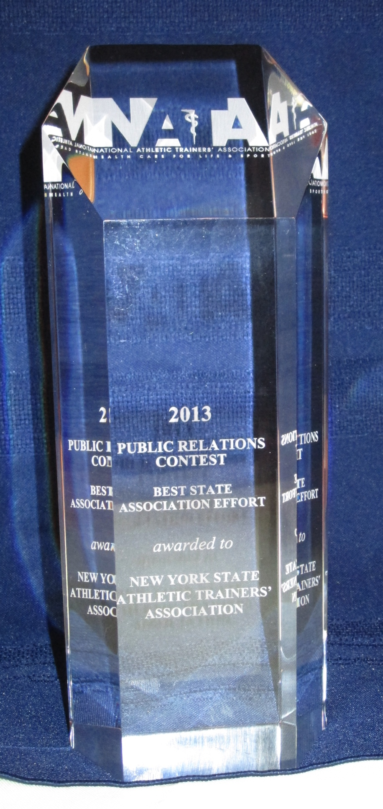
Public Relations Awards
NATA Public Relations Contest
2015 Best Overall Campaign: NYSATA
2014 Best State Association Effort: NYSATA
2013 Best State Association Effort: NYSATA

Slide 26
Continuing Efforts of the NYSATA
Concussion Awareness and Management Act, 2011
Necessitates updating the scope of practice of NY ATs
Thanks to Executive Board members, Governmental Affairs Chair/Committee, Public Relations Chair/Committee, and the NYS Athletic Training Committee
NYSATA participation in Albany Lobby Day
educate legislators & promote/improve the profession of athletic training in NYS

Slide 27
Continuing Efforts of the NYSATA
Continue to promote profession of athletic training
Push to provide “physically active” individuals the best healthcare services that can be offered by those in the athletic training profession
Goal to move from state certification to state licensure of athletic trainers
To protect the scope of practice of ATs

Slide 28
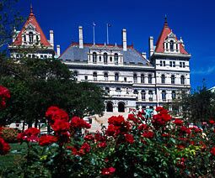
Governmental Affairs Committee Lobby Day 2012, Albany, NY

Slide 29
Lobby Day 2015, Albany NY

Slide 30
NATA Government Affairs Award Winners
Daniel L. Campbell Legislative Award (Class II) 2015 New York State Athletic Trainers Association (NYSATA)
Class II: Raising political visibility of profession and organization

Slide 31
NYS Athletic Training Bill
2012
NYSATA still using lobbyist Mary Ann McLean
NEW BILL introduced to Senate and Assembly
Working with other health care professions to avoid opposition
2014
Bill reintroduced
2016
Bill Passes Senate!
But doesn’t reach the Assembly
Definition for athletic training will change

Slide 32
Establishing the NYSATA Hall of Fame
Established in 1998 by President Marty Erb
to honor those athletic trainers who made a contribution to athletic training, primarily at the state level
Committee was formed to determine selection and to review nominations for those nominated to NYSATA Hall of Fame

Slide 33
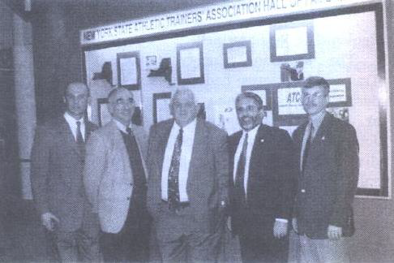
2002 Hall of Fame Dedication SUNY Buffalo

Slide 34
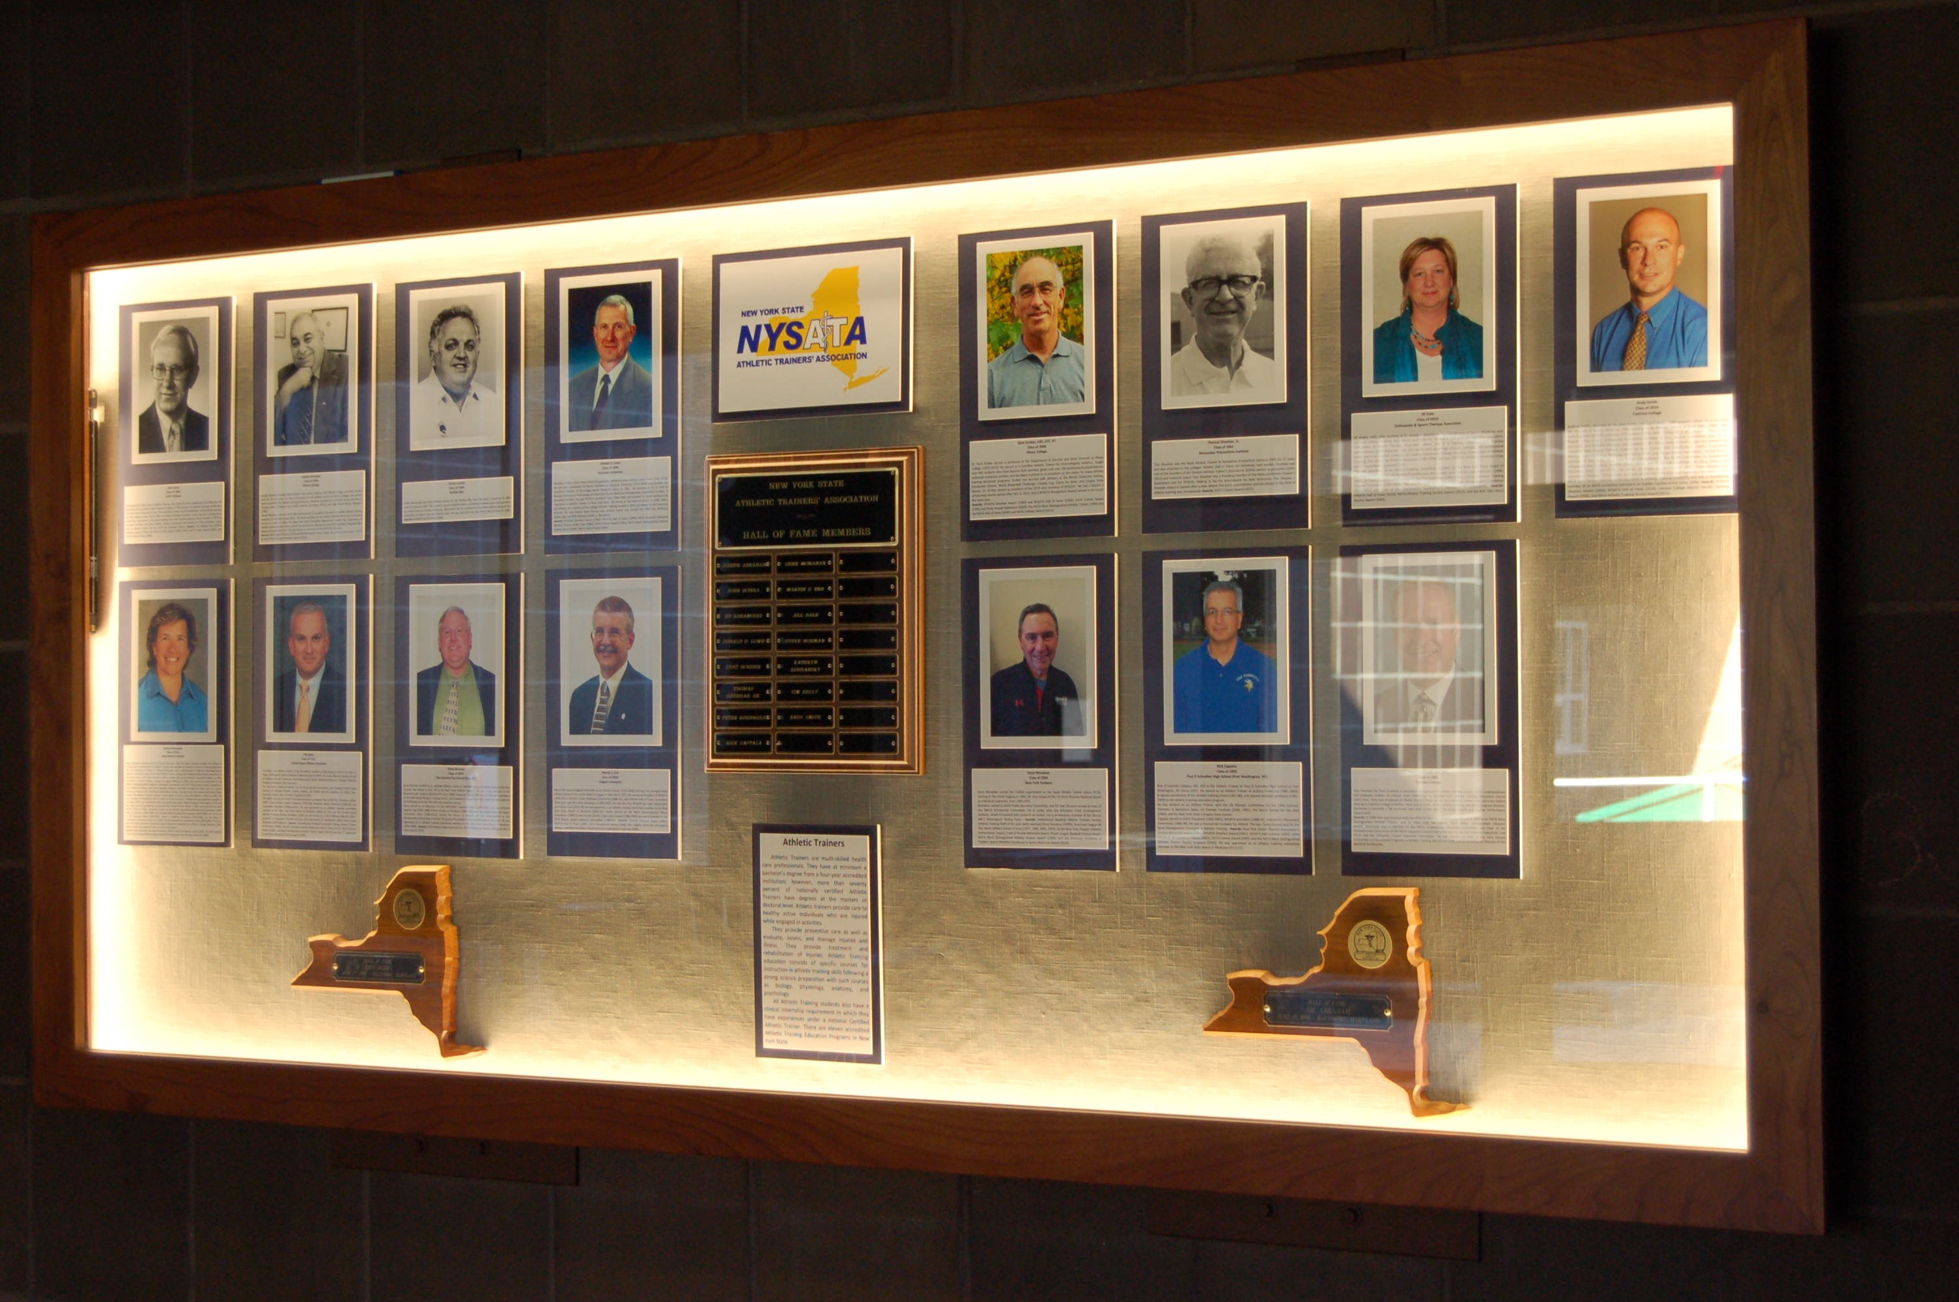
2016 Hall of Fame Dedication SUNY Cortland

Slide 35
NYSATA Hall of Fame Nominations
Any member of NYSATA may nominate someone who has done the following:
Been a certified athletic trainer for at least 15 years and at least 10 years in New York
Contributions to athletic training in NY state (NYSATA, Empire State Games, activities in the community)
High Profile position in NY State (may not allow for involvement above)
Additional considerations (involvement at District and National level)

Slide 36
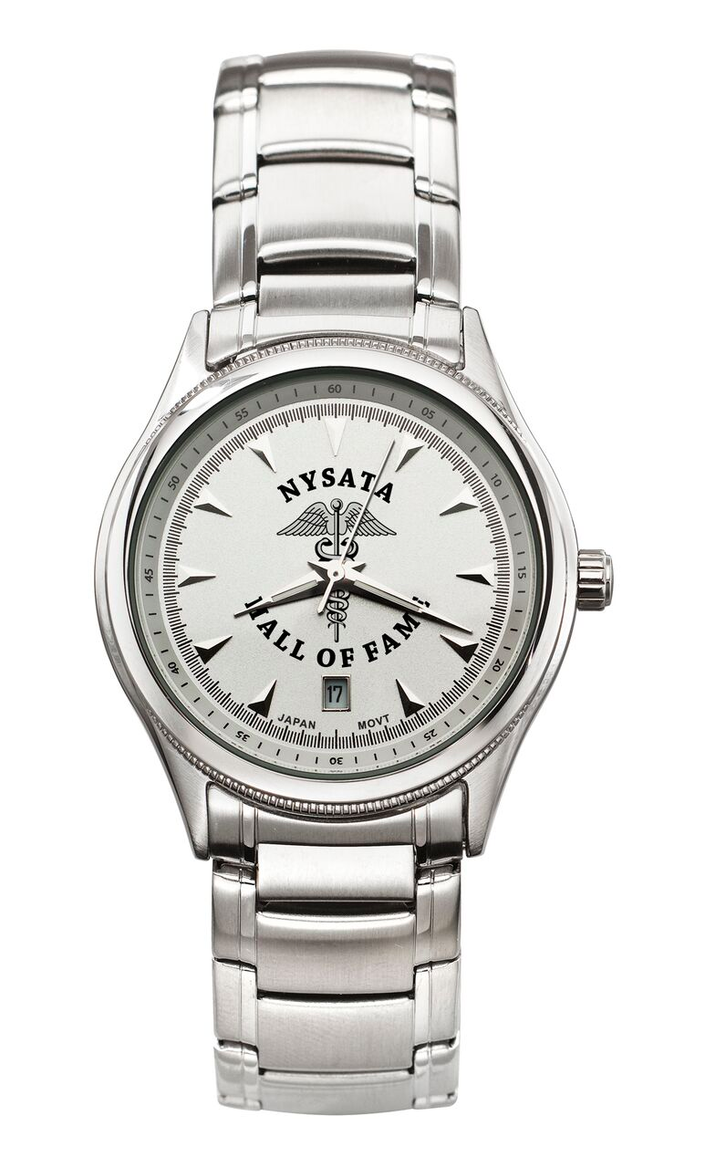
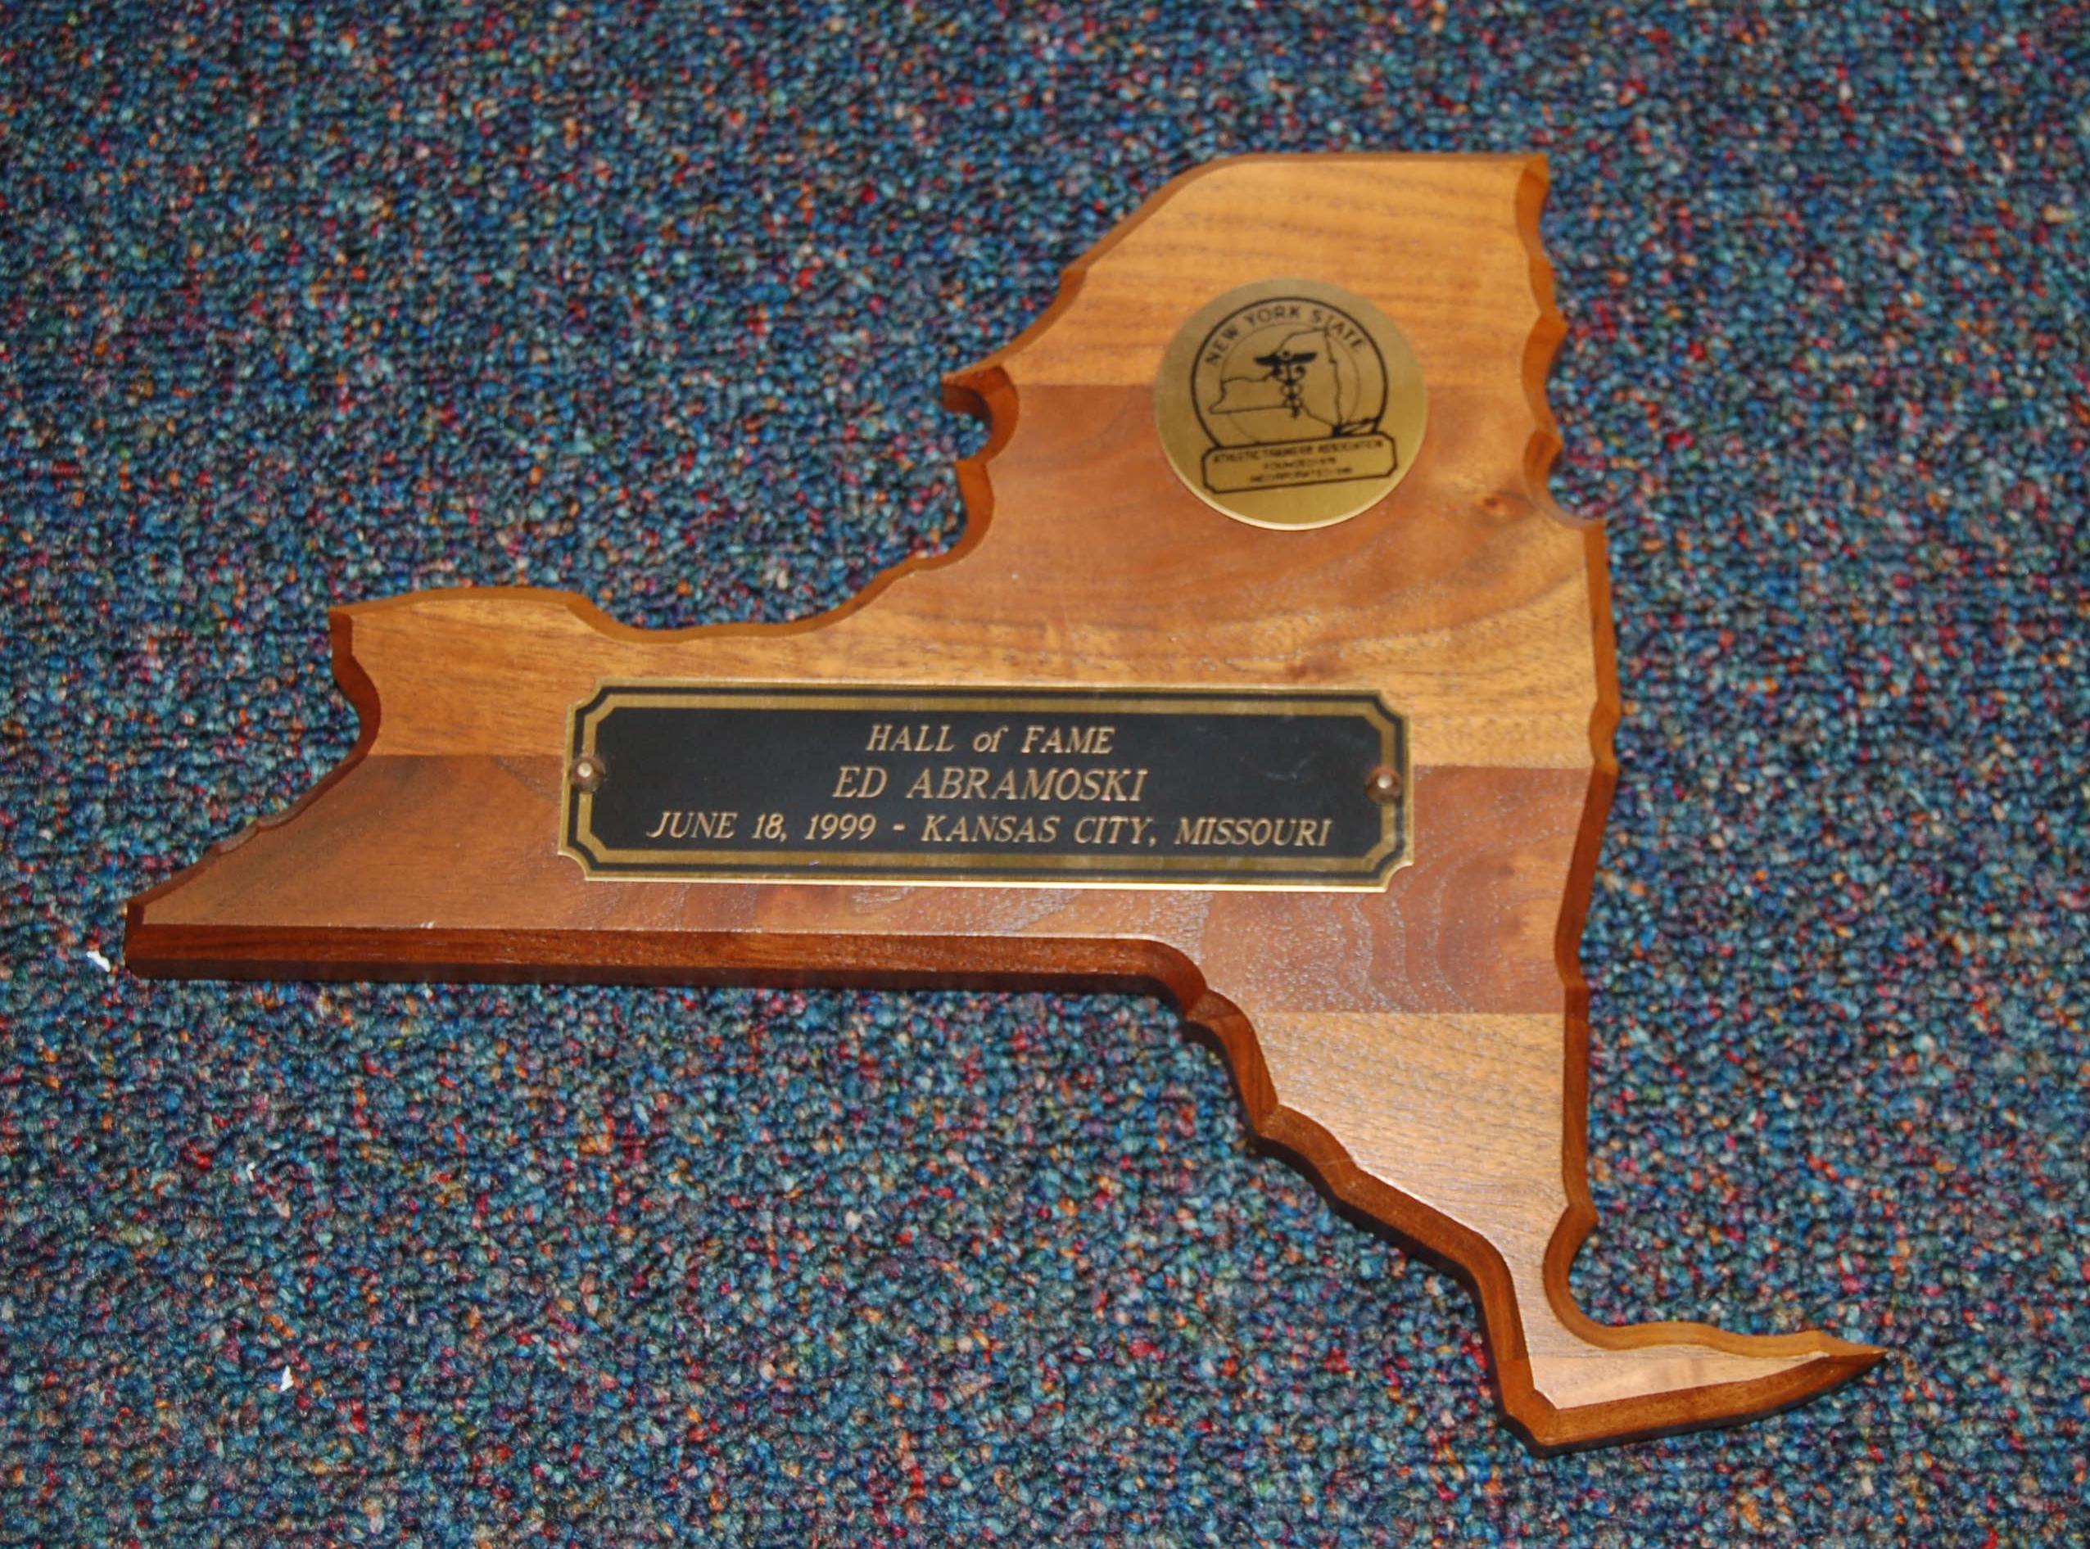
NYSATA Hall of Fame
Current Committee:
Deanna Errico, Chair
Kent Scriber
John Cottone
Robert Gariglio
Christopher Hobler

Slide 37
NYSATA Hall of Fame Members

Slide 38
A Big Thank You!!
Thank you to ALL ATHLETIC TRAINERS!!!!
Thank you to those athletic trainers in the Hall of Fame and those actively pursuing to improve the quality of care we can provide and promote our profession

